Slide 1




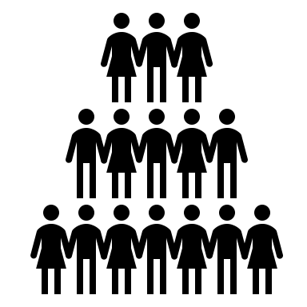
Benefits of Collaboration
Shared Cost
Shared Expertise
Shared Burden
Shared Reliability
Shared Credibility

Slide 2






Overcoming Challenges
Communication Differences
Take care, educate each other, consider co-mentoring trainees or hiring experts that speak your collaborator’s language
Different Styles and
Goals
Make unified standards and discuss what success means early and often
Different Capabilities
Make sure everyone has defined roles/tasks that use their expertise
Reduced Sense of Responsibility
Keep each other motivated with defined due dates (discuss dates to make sure they make sense!)
Research is Dynamic
Expect change and occasional failure
Different Resources
Be mindful of potential budget and resource differences

Slide 3
Overcoming Challenges
Communication Differences
Take care, educate each other, consider co-mentoring trainees or hiring experts that speak your collaborator’s language
Different Research Styles and Goals
make unified standards and discuss what success means to each collaborator early and often
Different Capabilities
make sure everyone has defined roles/tasks that use their expertise
Reduced Sense of Responsibility
Keep each other motivated with defined due dates
(discuss these with everyone to make sure they make sense!)
Research is Dynamic
Expect change and occasional failure
Different Resources
Be mindful of potential budget and resource differences

Slide 4
Jack - the only & lonely informaticist
Yeah, Jack can do that...
You said 20 samples right?
Yeah, that will probably only take
20 minutes
Oh dear, that sounds like at least 2 weeks of work
...

Slide 5
Jack - the only & lonely informaticist
Yeah, Jack can do that...
You said 20 samples right?
Yeah, that will probably only take
20 minutes
Oh dear, that sounds like at least 2 weeks of work
...

Slide 6
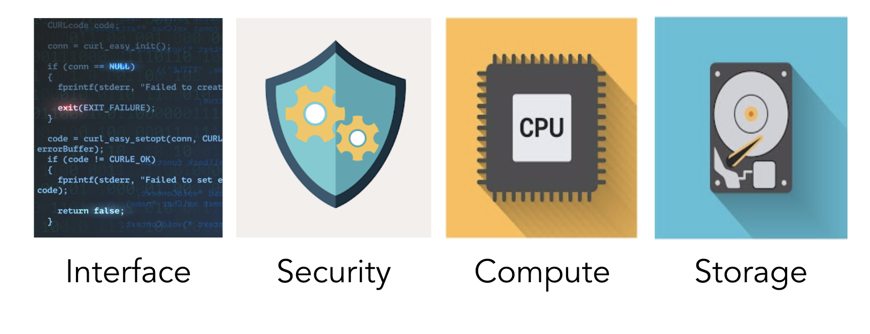
Interface
Security
Power
Storage
Image created by macrovector - www.freepik.com

Slide 7


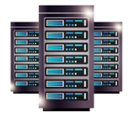
Personal Computers
Laptop
Desktop
Server
Image created by macrovector - www.freepik.com
<a href='https://www.freepik.com/vectors/frame'>Frame vector created by macrovector - www.freepik.com</a>

Slide 8
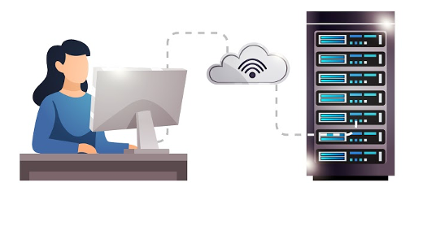
Servers can enhance computational power and storage
Image created by macrovector - www.freepik.com

Slide 9

Shared Computers
Institutional High Performance
Computing (HPC) Clusters
National Computing
Resources
Image created by macrovector - www.freepik.com

Slide 10




Cloud Computing
Image created by macrovector - www.freepik.com

Slide 11

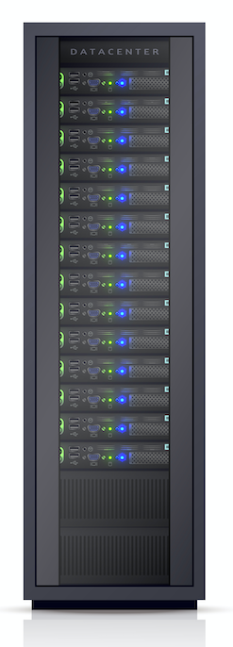
<a href='https://www.freepik.com/vectors/frame'>Frame vector created by macrovector - www.freepik.com</a>
<a href='https://www.freepik.com/vectors/frame'>Frame vector created by macrovector - www.freepik.com</a>

Slide 12
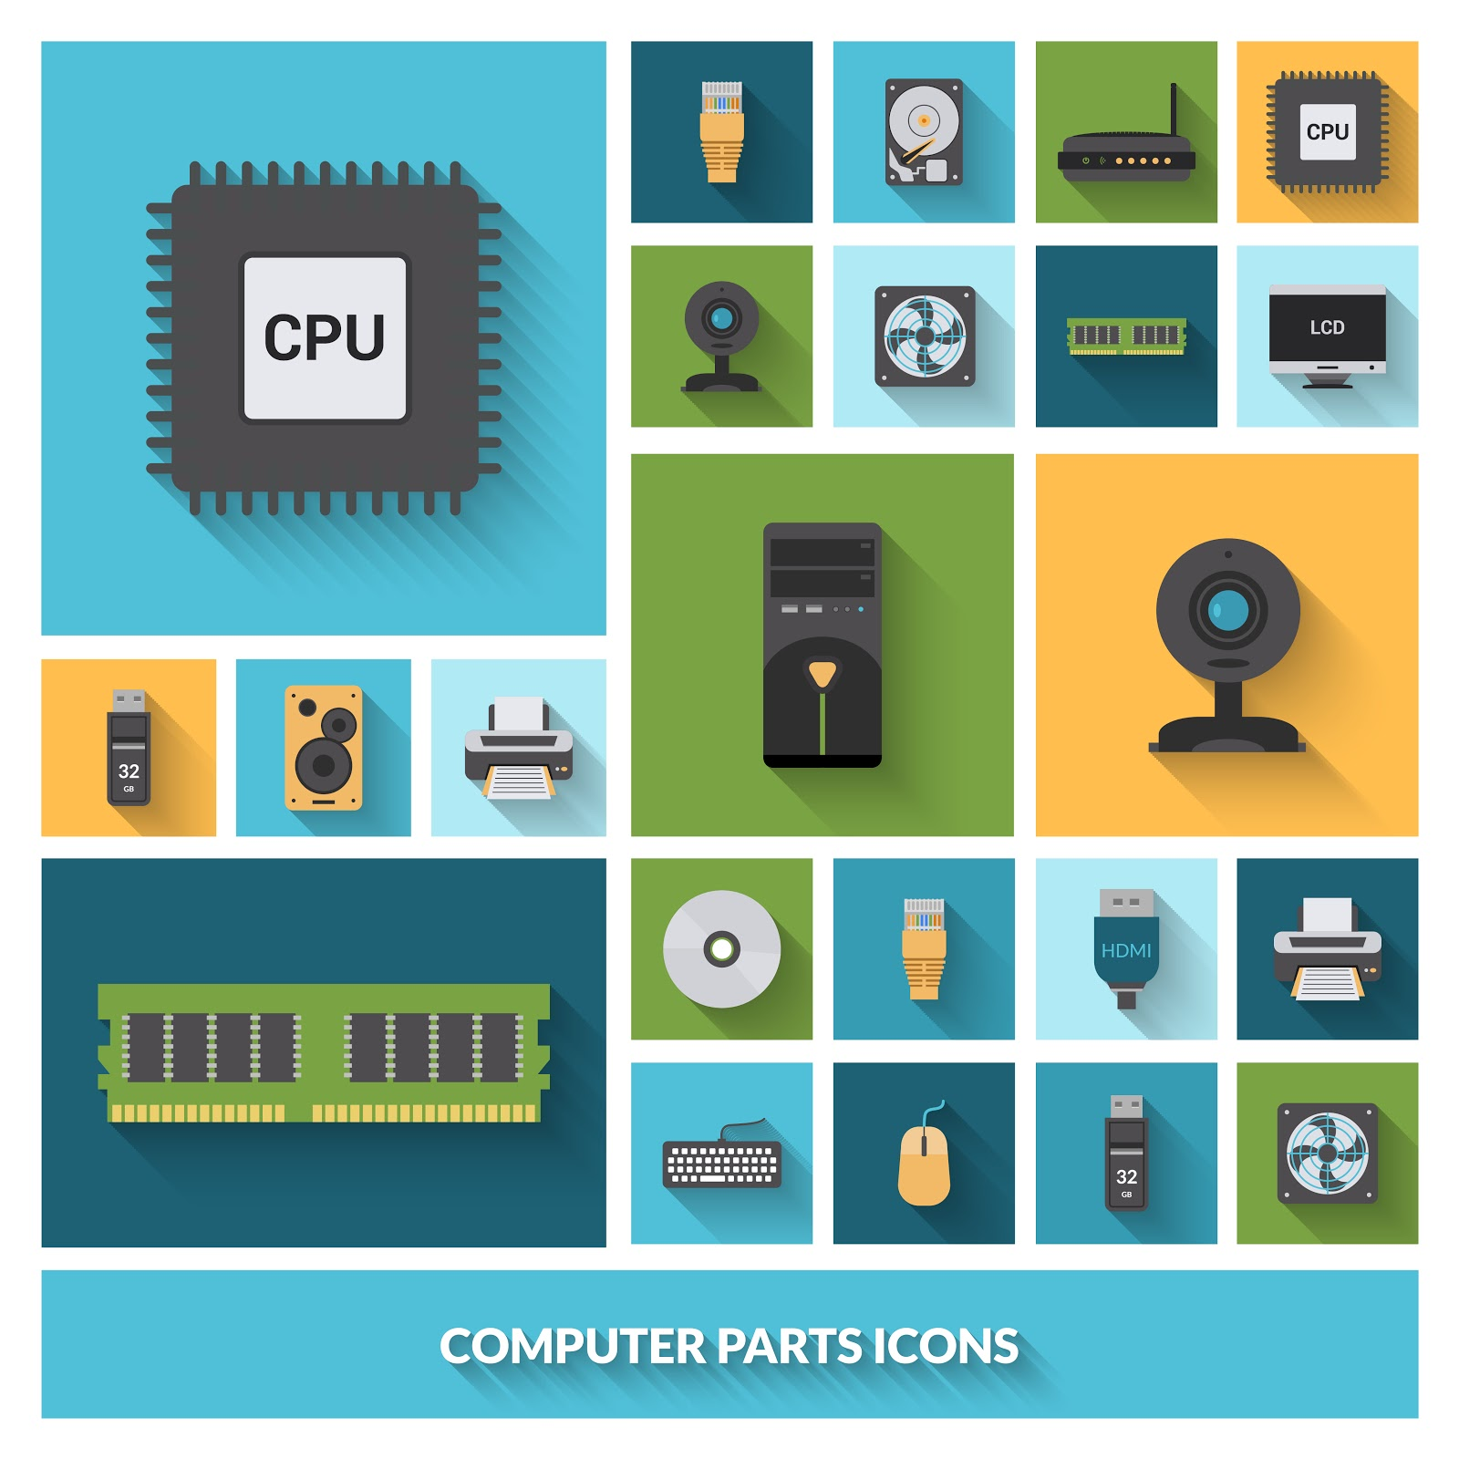


Interface
Security
Compute
Storage

Slide 13
Image created by macrovector - www.freepik.com

Slide 14
Image created by macrovector - www.freepik.com

Slide 15
Image created by macrovector - www.freepik.com

Slide 16
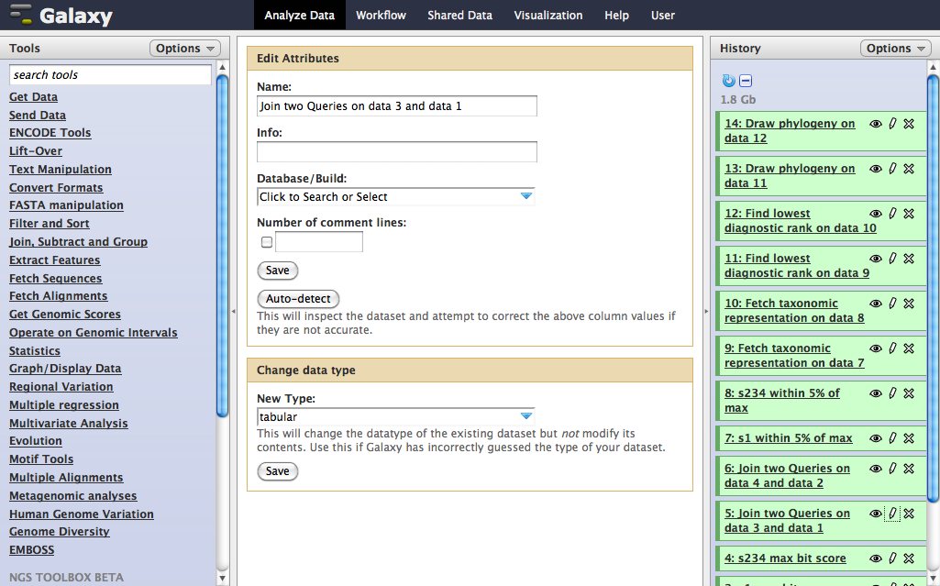

Slide 17
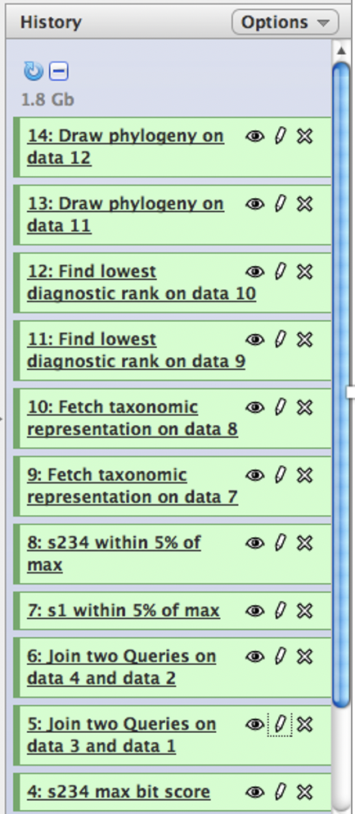

Slide 18
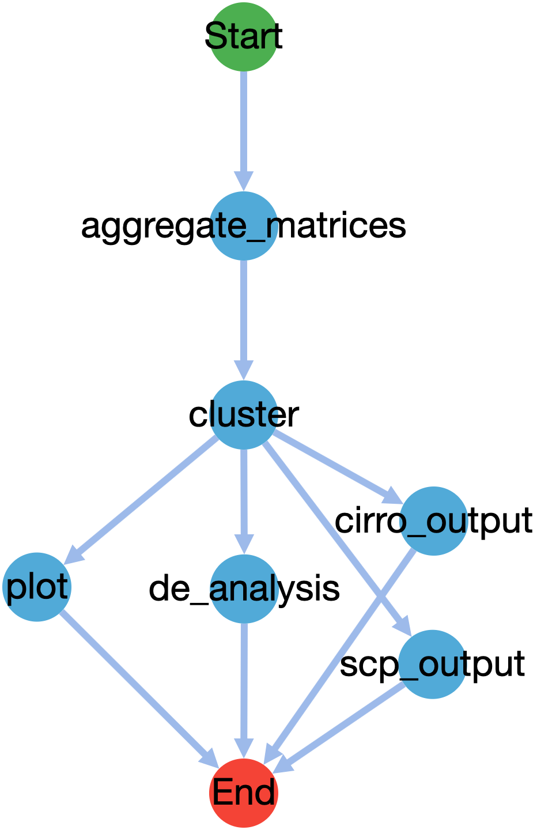

Slide 19
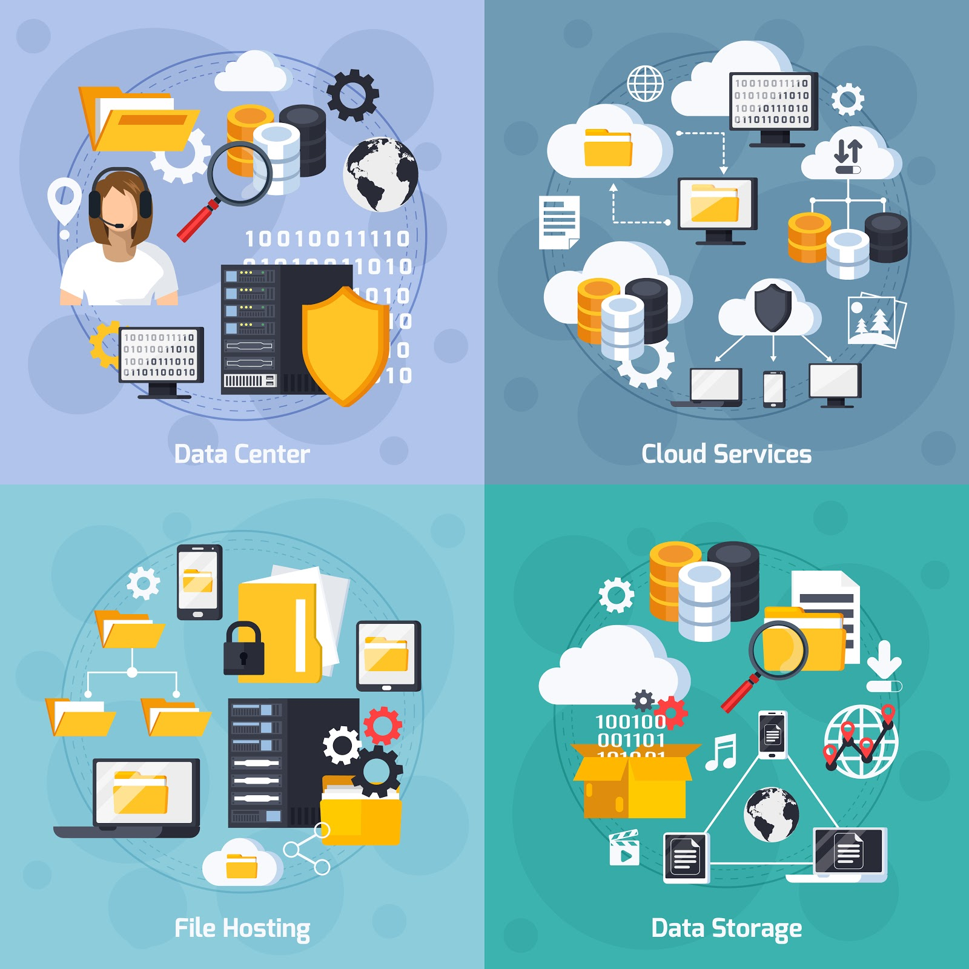

Slide 20
<a href='https://www.freepik.com/vectors/frame'>Frame vector created by macrovector - www.freepik.com</a>
<a href='https://www.freepik.com/vectors/technology'>Technology vector created by stories - www.freepik.com</a>

Slide 21
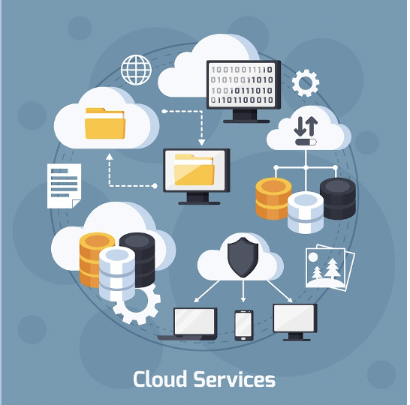
Image created by macrovector - www.freepik.com

Slide 23
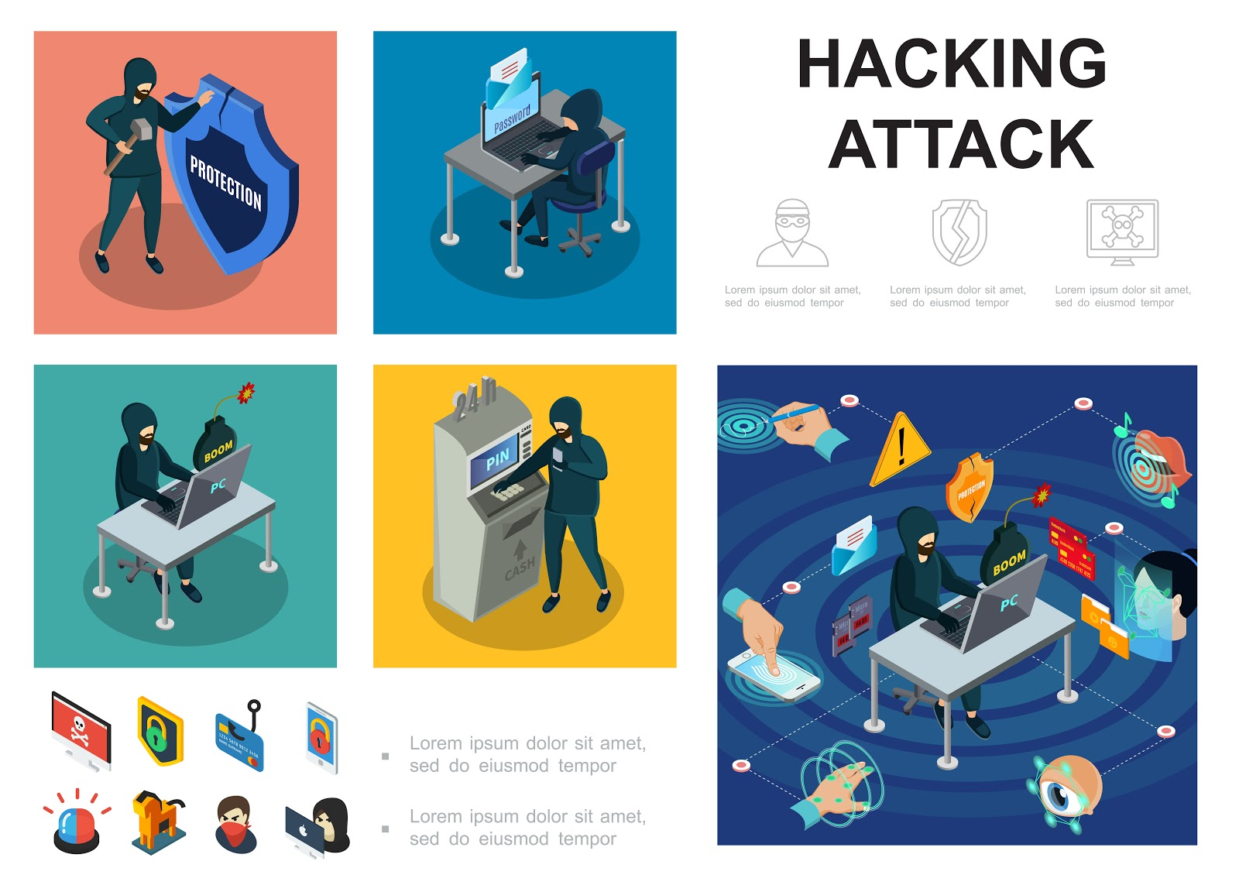

Slide 24
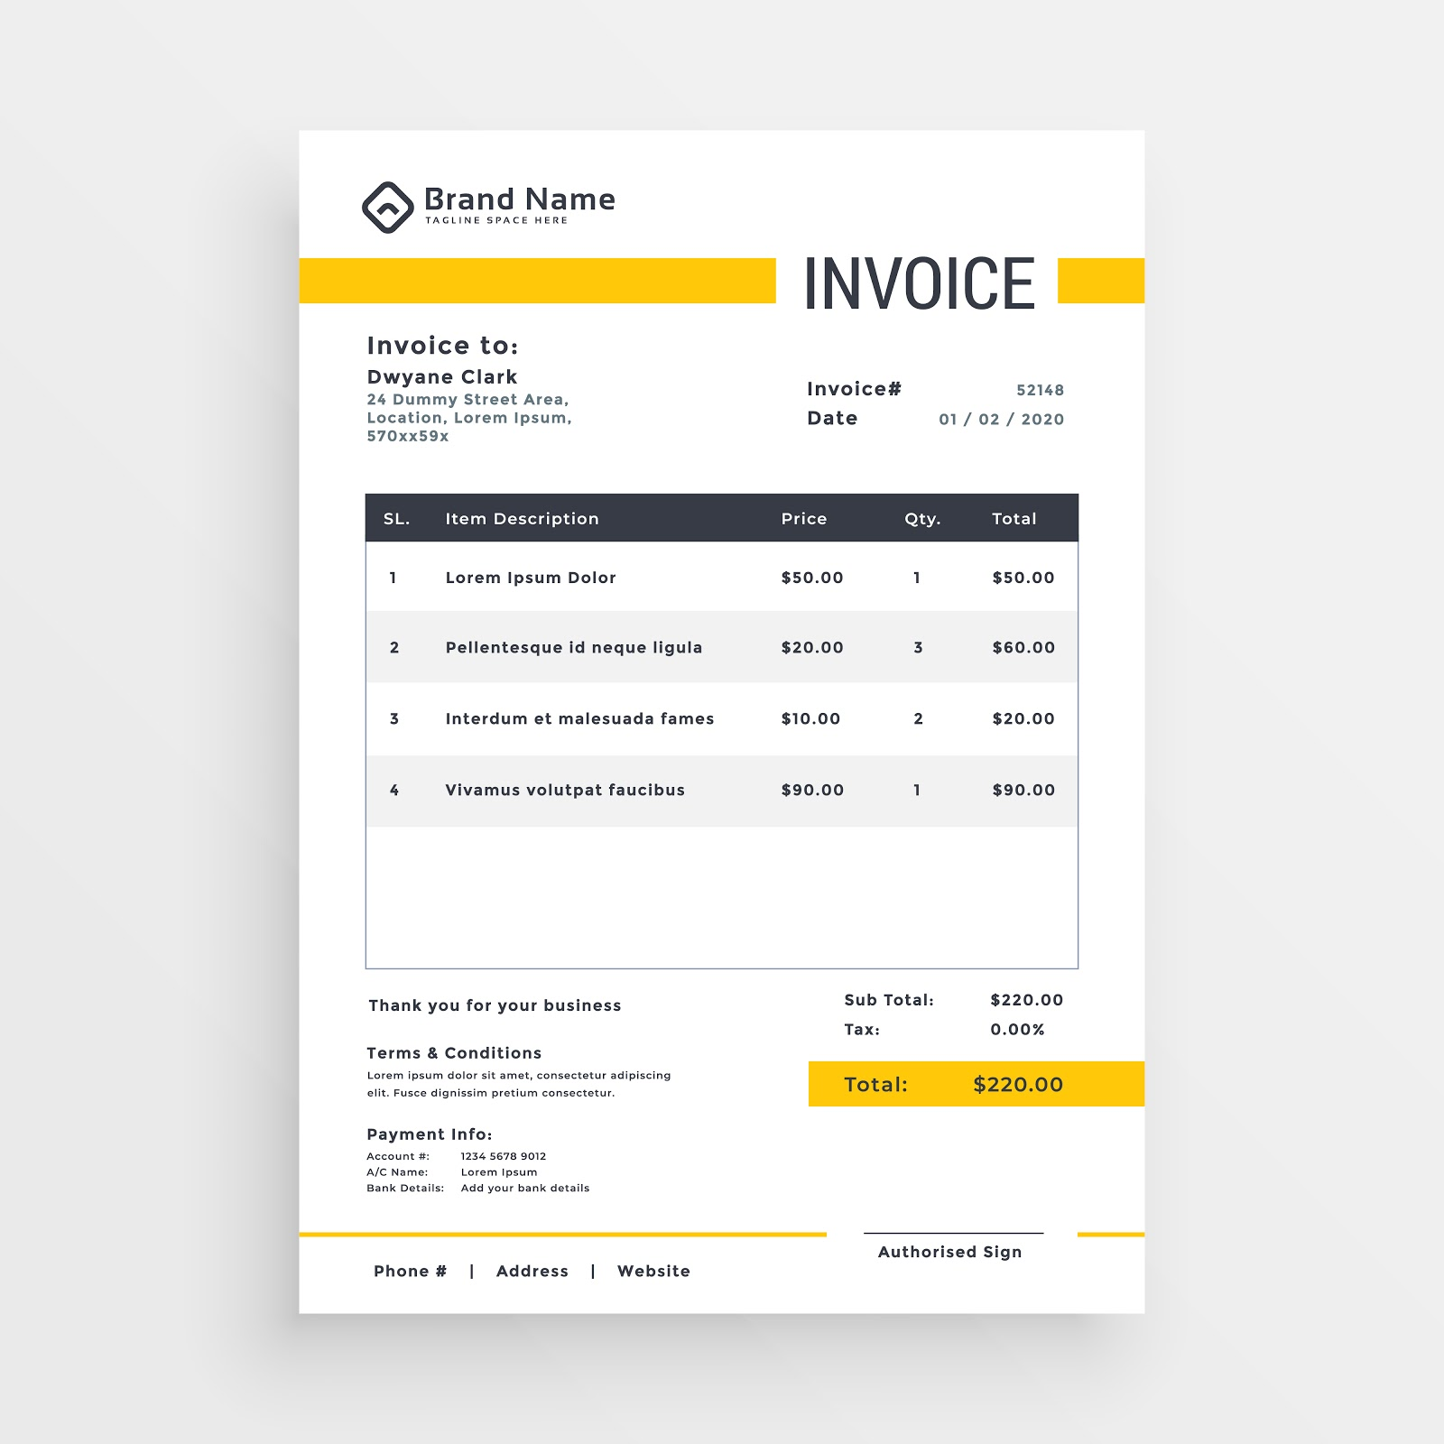

Slide 25


Slide 26


Image created by macrovector - www.freepik.com

Slide 27


Local Storage
Cloud Storage
Image created by macrovector - www.freepik.com

